Slide 1
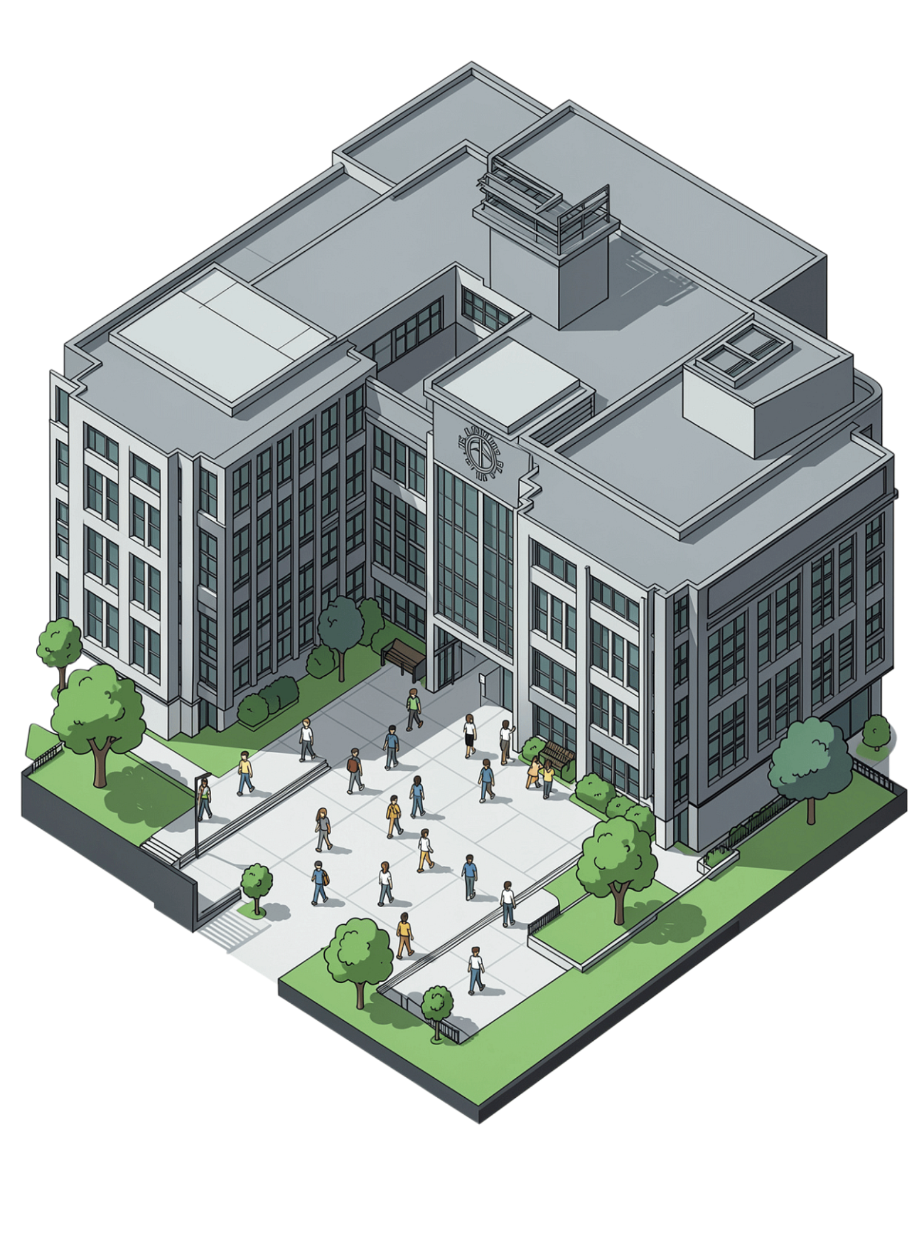
University Grade & Attendance Tracker
A Java-based academic management system for real-time grade and attendance monitoring.
Thota Venkata Harsha Vardhan
Roll No: 2620030071
Team Member
Sheri Raja Manideep
Roll No: 2620030406
Team Member

Slide 2

System Overview
A comprehensive academic tracking platform designed to give students and instructors full visibility into performance and attendance — all in one place.
Real-Time Tracking
Automated Notifications
Unified Dashboard
Monitor student grades and attendance instantly as data is recorded.
System alerts triggered automatically for low attendance or failing grades.
Instructors and students share a progress-monitoring interface tailored to each role.

Slide 3



Core Features
Grade Management
Attendance Logging
Smart Alerts
Record, calculate, and display weighted grades across all courses with precision and transparency.
Track daily attendance session-by-session with automated weekly and monthly reports.
Notify students automatically when attendance drops below defined thresholds or grades fall critically low.

Slide 4
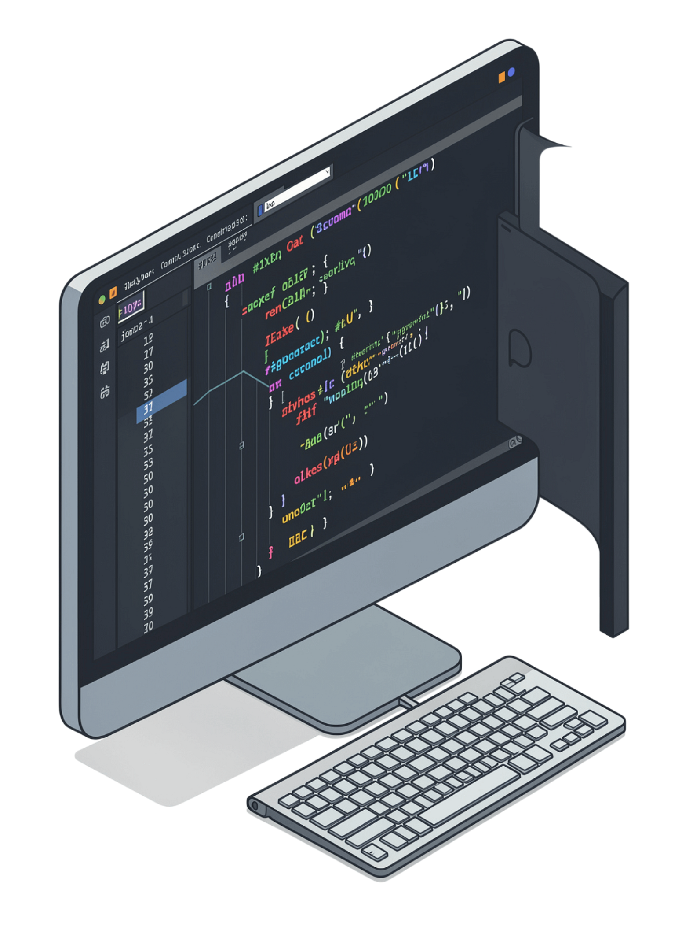


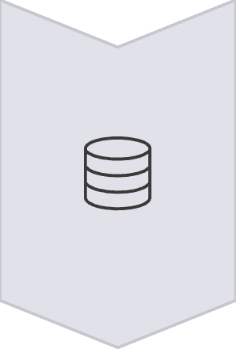
Java Implementation Stack
Spring Boot
Backend REST API endpoints for all data operations
JavaFX
Desktop UI dashboard with responsive interface components
MySQL
Relational database storing all student records and grade data

Slide 5

Sample Code: Grade Calculator
How It Works
public class GradeCalculator {
public static double calculateGPA(
double[] grades) {
double total = 0;
for (double grade : grades) {
total += grade;
}
return Math.round(
(total / grades.length) * 100.0
) / 100.0;
}
public static void main(String[] args) {
double[] studentGrades =
{85, 90, 78, 92};
System.out.println(
"GPA: " + calculateGPA(studentGrades)
);
}
}
01
Input Array
Accepts a double[] array of raw grade values per student.
02
Summation Loop
Iterates over each grade, accumulating a running total.
03
Precision Output
Returns GPA rounded to 2 decimal places using Math.round.
Output: GPA: 86.25 for grades {85, 90, 78, 92}

Slide 6
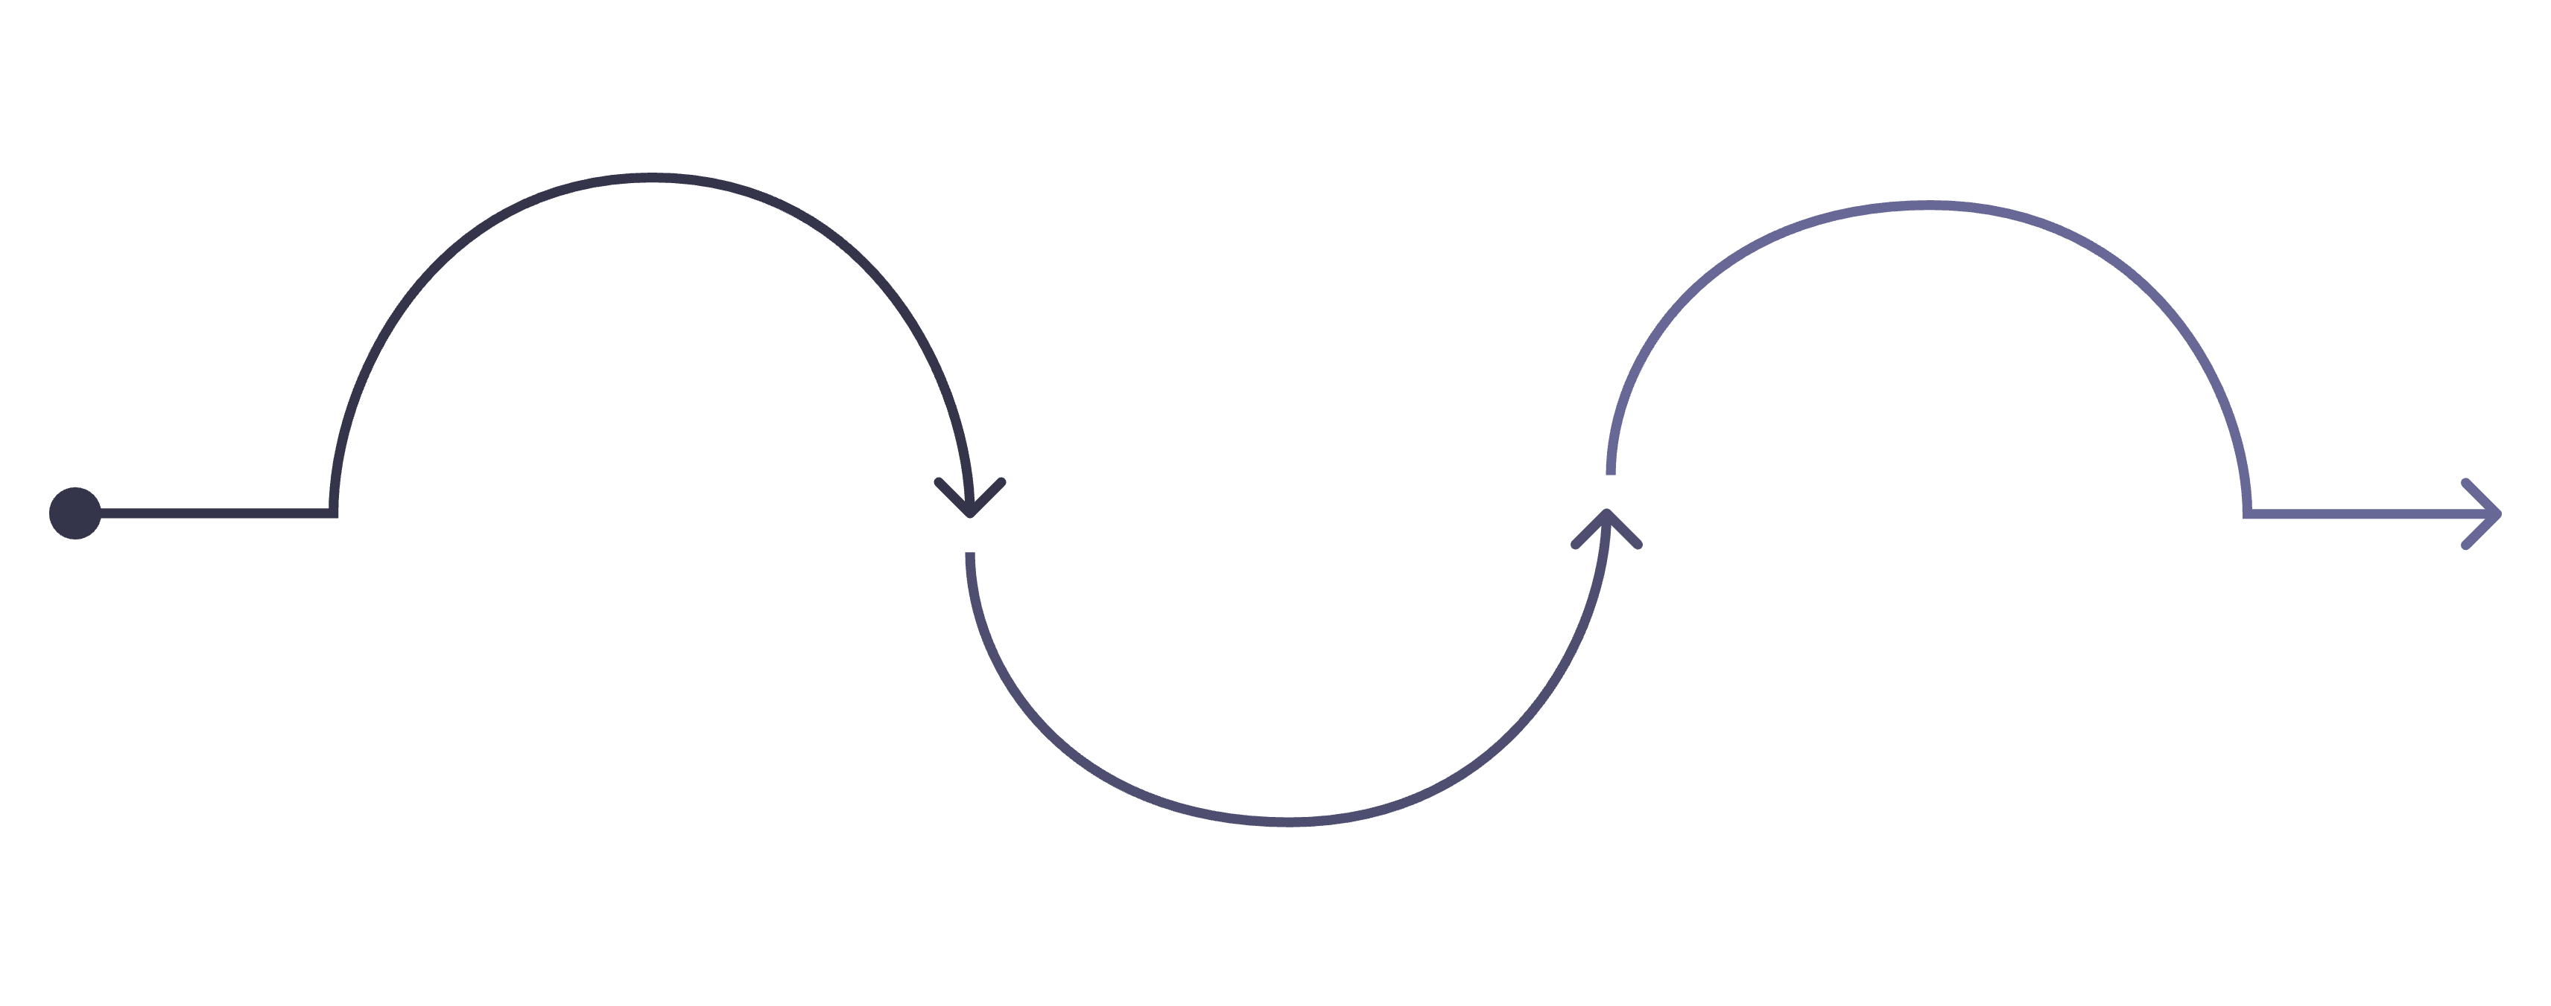
Next Steps
Phase 1
Phase 3
Design MySQL schema for students and grades
Phase 2
Create JavaFX dashboard with real-time updates
Implement Spring Boot REST CRUD endpoints
The roadmap follows a layered build approach — data layer first, then API logic, then the user-facing interface — ensuring each layer is stable before the next is built on top.

